Slide 1
UNIT – II
-Stacks
-Queues

Slide 2
Contents
Dynamic Linear Data Structure:
Stacks,
Stack operations,
Characteristics of a Stacks,
Applications of Stacks.
Dynamic Linear Data Structure:
Queues,
Characteristics of a Queues,
Circular Queues,
Applications of Queue.

Slide 3
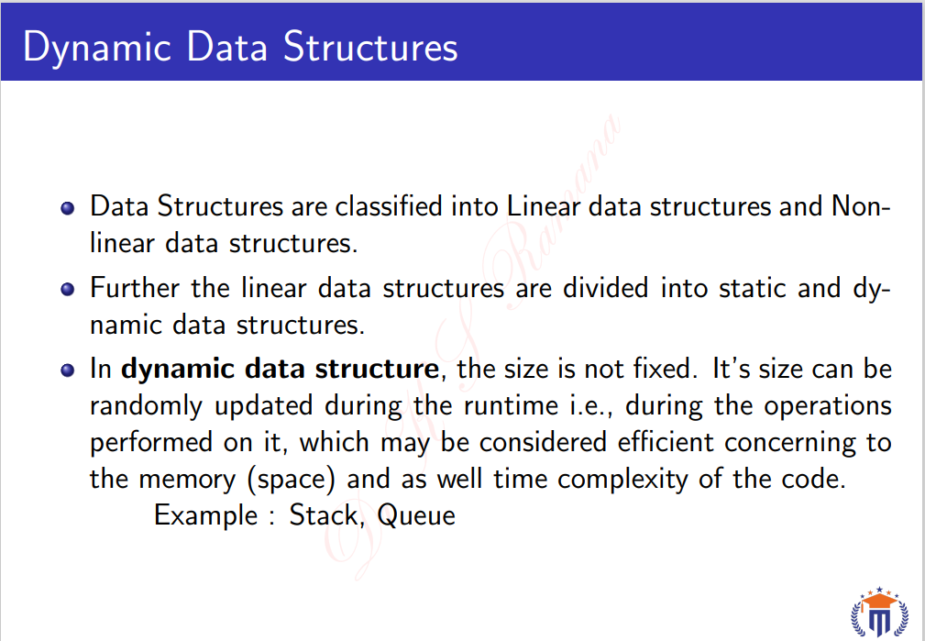

Slide 4
What is Stack?
In the English dictionary the word stack means “arranging objects one over another ”. In the same way, memory is allocated in stack data structure.
Stacks is a linear type of data structure that follows a particular order and allows insertion and deletion operations from one end of the stack data structure, that is top.
The order may be LIFO(Last In First Out) or FILO(First In Last Out).
LIFO implies that the element that is inserted last, comes out first and FILO implies that the element that is inserted first, comes out last.
Stacks are simple data structures that allow us to store and retrieve data sequentially.

Slide 5
Stack looks like tube, closed on one side and open on other side.
A stack is a limited access data structure - elements can be added and removed from the stack only at the top.
We can perform the two basic operations in the stack - PUSH and POP.
The PUSH operation is used to add an element.
The POP operation is used to remove an element from the stack.

Slide 6
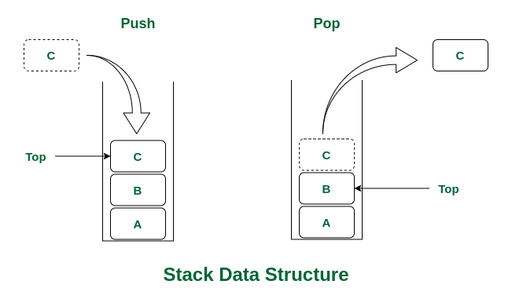
If you push, elements that are added at the top of the stack and if you pop, elements are removed from the top of the stack.
D
C
B
A

Slide 7
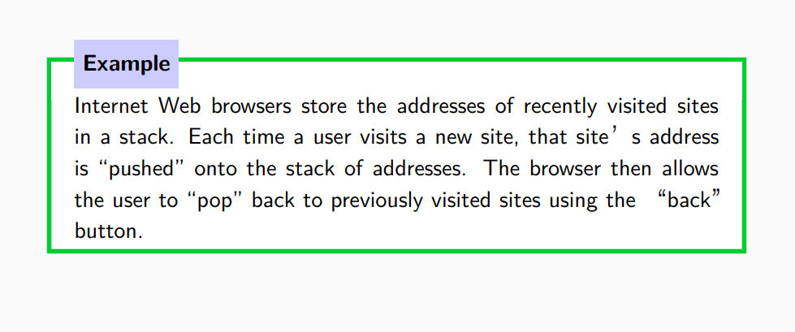

Slide 8
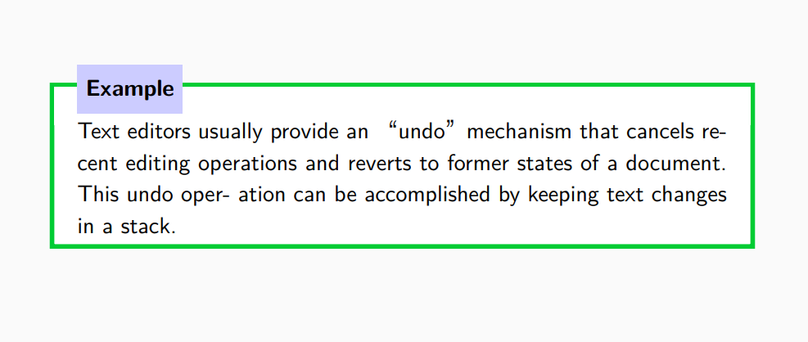

Slide 9
Basic Operations on Stack
In order to make manipulations in a stack, there are certain operations provided for stacks. They are,
push()
pop()
top()/peek() -Returns the top element of the stack.
isEmpty() -returns true if stack is empty else false.
size() -returns the size of stack.

Slide 10
Push operation on a full stack causes stack overflow, means not enough space to an element in stack.
Pop operation on an empty stack causes stack underflow, means there are no entities to remove from it.
Attempting the execution of an operation may sometimes cause an error condition, called an” Exception”.
Exceptions are said to be thrown by an operation that cannot be executed.
Operations “pop”and “top”cannot be performed if the stack is empty.

Slide 11
The Stack Abstract Data Type
Stacks are the simplest of all data structures, yet they are also among the most important.
Formally, a stack is an abstract data type (ADT) such that an instance S
supports the following methods:
• S.push(e): Add element e to the top of stack S.
• S.pop(): Remove and return the top element from the stack S.
S.top(): Return a reference to the top element of stack S, without removing it;
• S.isEmpty(): Return True if stack S does not contain any elements.
• S.size(): Return the number of elements in stack S;

Slide 12
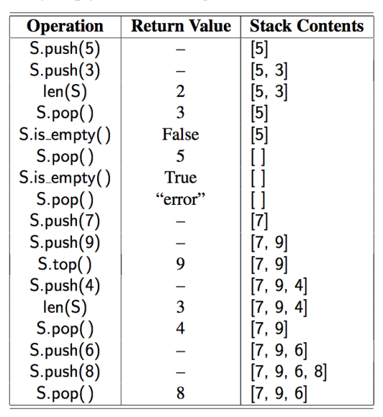

Slide 13
Push:[ Algorithm ]:
Adds an item to the stack. If the stack is full, then it is said to be an Overflow condition
begin
if stack is full
return
endif
else
increment top
stack[top] assign value
end else
end procedure
top
top=-1
top
D
top
C
top
B
top
A

Slide 14
Pop:[ Algorithm ]:
Removes an item from the stack. The items are popped in the reversed order in which they are pushed.
If the stack is empty, then it is said to be an Underflow condition.
begin
if stack is empty
return
endif
else
store value of stack[top]
decrement top
return value
end else
end procedure

Slide 15
Top:[ Algorithm ]:
begin return stack[top] end procedure
Returns the top element of the stack.
begin
return stack[top]
end procedure

Slide 16
isEmpty :[ Algorithm ]:
begin return stack[top] end procedure
Returns true if the stack is empty, else false.
begin
if top < 1
return true
else
return false
end procedure

Slide 17
size :[ Algorithm ]:
begin return stack[top] end procedure
Returns true if the stack is empty, else false.
Begin
Count=0
While stack is not empty
stack.pop()
count+=1
return Count
end procedure

Slide 18
Stack Implementation
The Stack data structure can be implemented in different ways.
Using List
Using deque
Using LifoQueue

Slide 19
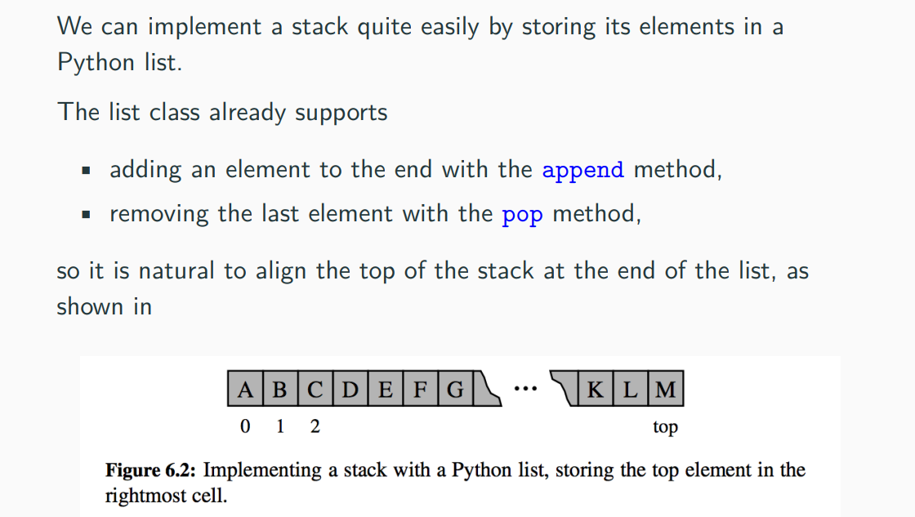
Simple List based Stack Implementation

Slide 20
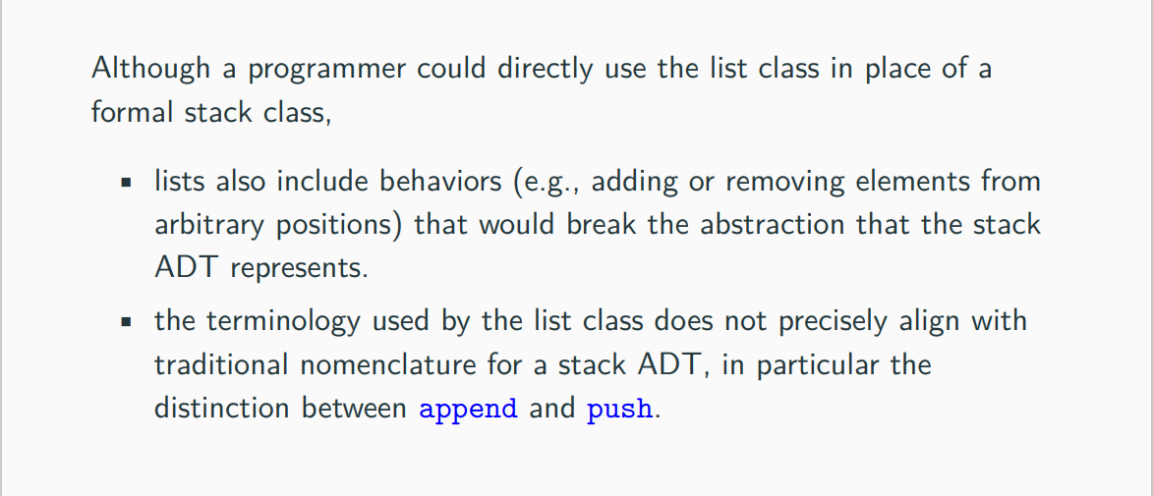
Simple List based Stack Implementation

Slide 21
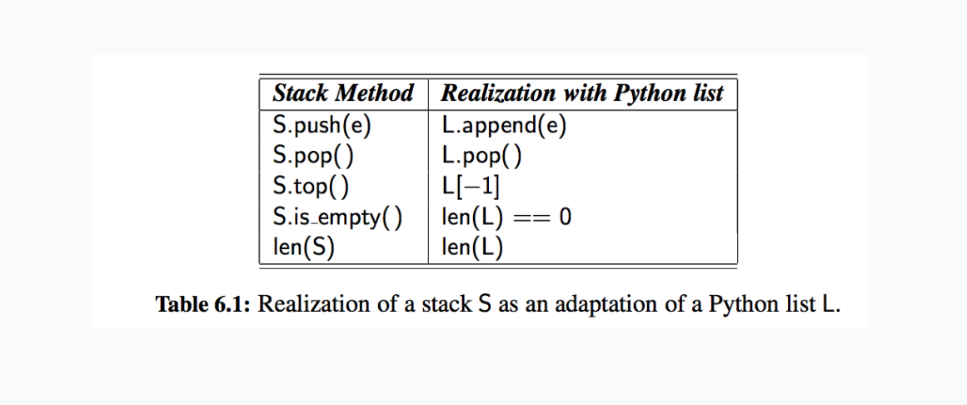
Simple List based Stack Implementation

Slide 22
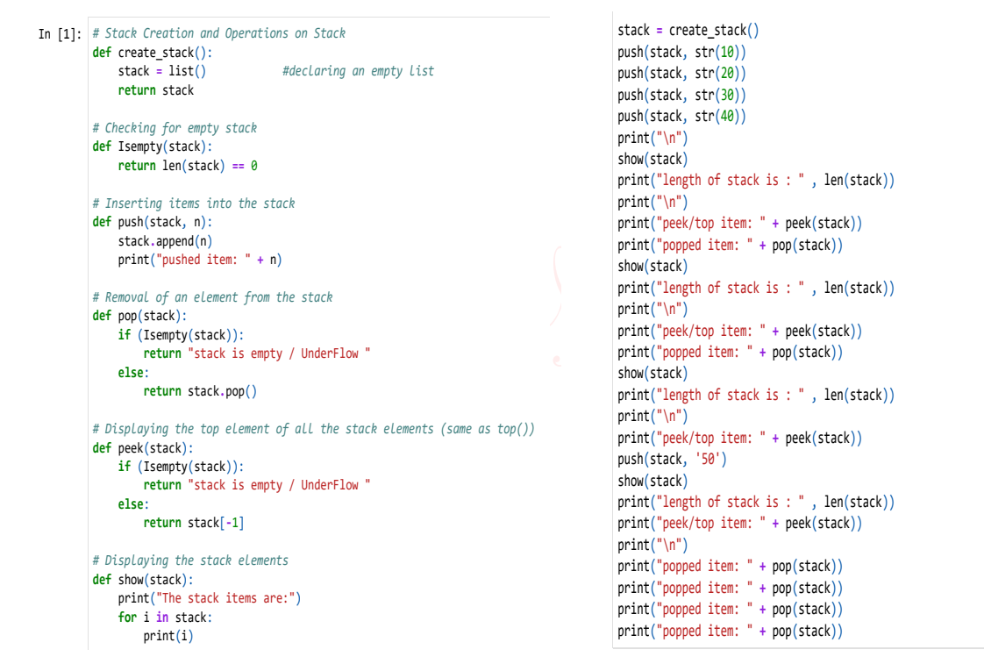

Slide 23
Characteristics of a Stacks
LIFO ordering: The last item pushed onto the stack is the first item popped off the stack.
Push and Pop Operations: The two primary operations that can be performed on a stack are "push," which adds an item to the top of the stack, and "pop," which removes the item from the top of the stack.
Top Element Access: A stack allows access only to the top element, which is the most recently added item. Other elements are not directly accessible and must be removed first.
Limited Accessibility: Stacks do not allow access to elements in the middle of the stack. To access a specific element, all elements on top of it must be removed first.

Slide 24
Dynamic Size: Stacks can grow or shrink dynamically as items are added or removed.
Contiguous Memory Allocation: Stacks typically use contiguous memory allocation, meaning that elements are stored in adjacent memory locations.
Stack Overflow: A stack has a finite amount of memory allocated to it. When the stack exceeds this memory limit, a stack overflow occurs.
Stack Underflow: A stack underflow occurs when an attempt is made to remove an element from an empty stack.
These characteristics make stacks useful for many applications, such as implementing recursive function calls, undo-redo operations, and parsing expressions.

Slide 25
Advantages of Stack:
Stacks are simple data structures with a well-defined set of operations, which makes them easy to understand and use.
Stacks are efficient for adding and removing elements.
In order to reverse the order of elements we use the stack data structure.
Stacks can be used to implement undo/redo functions in applications.

Slide 26
Drawbacks of Stack:
Restriction of size in Stack is a drawback and if they are full, you cannot add any more elements to the stack.
Stacks do not provide fast access to elements other than the top element.
Stacks do not support efficient searching, as you have to pop elements one by one until you find the element you are looking for.

Slide 27
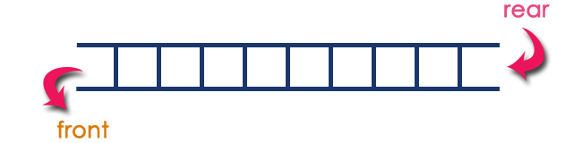
Queue
What is a Queue?
Queue is a linear data structure in which the insertion and deletion operations are performed at two different ends.
The insertion is performed at one end and deletion is performed at other end.
In a queue data structure,
The insertion operation is performed at a position which is known as 'rear' and
The deletion operation is performed at a position which is known as 'front'.
In queue data structure, the insertion and deletion operations are performed based on FIFO (First In First Out) principle.

Slide 28
Queue
How are Queues Used
The concept of a queue can be explained by observing a line at a reservation counter.
When we enter the line we stand at the end of the line and the person who is at the front of the line is the one who will be served next. He will exit the queue and be served.
As this happens, the next person will come at the head of the line, will exit the queue and will be served. As each person at the head of the line keeps exiting the queue, we move towards the head of the line.
Finally we will reach the head of the line and we will exit the queue and be served.
This behavior is very useful in cases where there is a need to maintain the order of arrival.

Slide 29
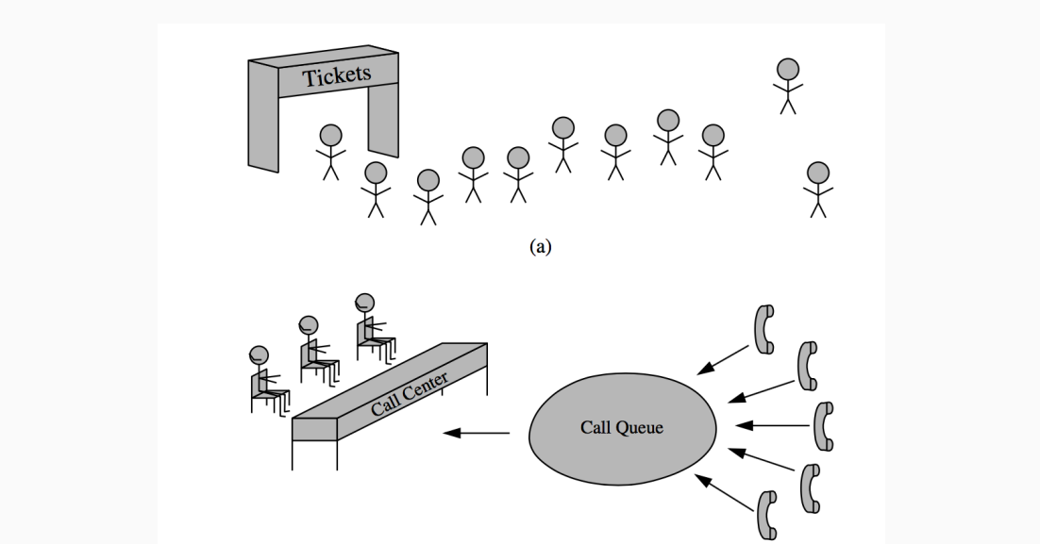
Queue

Slide 30
Queue
There are four different types of queues:
Simple Queue
Circular Queue
Priority Queue
Double Ended Queue

Slide 31
Queue
Queue ADT
The following operations make a queue an ADT.
Insertions and deletions in the queue must follow the FIFO scheme.
Main Queue Operations
enqueue(data): Inserts an element at the end of the queue
dequeue(): Removes and returns the element at the front of the queue
Auxiliary Queue Operations
front(): Returns the element at the front without removing it
size(): Returns the number of elements stored in the queue
is_empty(): Indicates whether no elements are stored in the queue or not

Slide 32
Queue
Exceptions
Similar to other ADTs, executing DeQueue on an empty queue throws an "Empty Queue Exception" and executing EnQueue on a full queue throws a " Full Queue Exception".
Applications
Operating systems schedule jobs (with equal priority) in the order of arrival (e.g., of print queue).
Simulation of real-world queues such as lines at a ticket counter or any other first-come first-served scenario requires a queue.
Multiprogramming.
Asynchronous data transfer (file 10, pipes, sockets).
Waiting times of customers at call center.
Determining number of cashiers to have at a supermarket.

Slide 33
Queue
This simple implementation of Queue ADT uses an array.
In the array, we use two variables to keep track of the start element and end element.
Generally, front is used to indicate the start element and rear is used to indicate the end element in the queue.
The array storing the queue elements may become full.
An EnQueue operation will then throw a full queue exception.
Similarly, if we try deleting an element from an empty queue it will throw empty queue exception.
Note: initially, both front and rear points to - 1 which indicates that the queue is empty.

Slide 34
Queue
The queue abstract data type (ADT) supports the following two fundamental methods for a queue Q:
Q.enqueue(e): Add element e to the back of queue Q.
Q.dequeue(e): Remove and return the first element from queue Q; an error occurs if the queue is empty.
The queue ADT also includes the following supporting methods
Q.first(): Return a reference to the element at the front of queue Q, without removing it; an error occurs if the queue is empty.
Q.is_empty(): Return True if queue Q does not contain any elements.
Q.size(): Return the number of elements in queue Q; in Python.

Slide 35
Queue

Slide 36
Queue
Implementation
There are many ways (similar to Stacks) of implementing queue operations and some of the commonly used methods are listed below.
• Simple array based implementation
• Dynamic circular array based implementation
• Linked list implementation

Slide 37
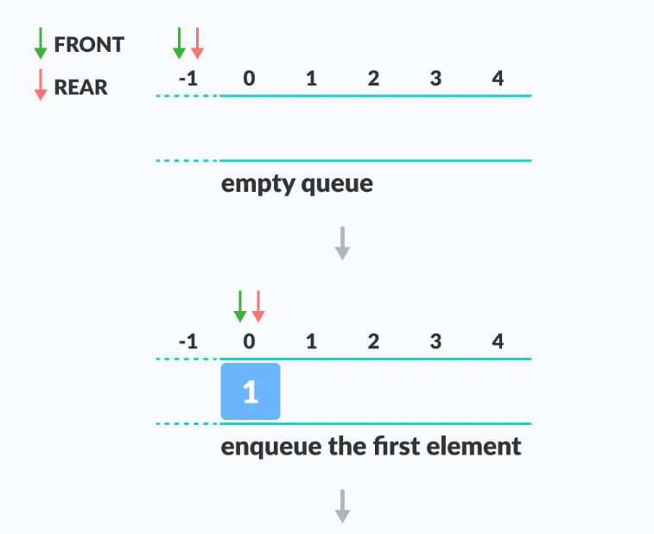
Queue Simple Queue
In a simple queue, insertion takes place at the rear and removal occurs at the front. It strictly follows the FIFO (First in First out) rule.

Slide 38
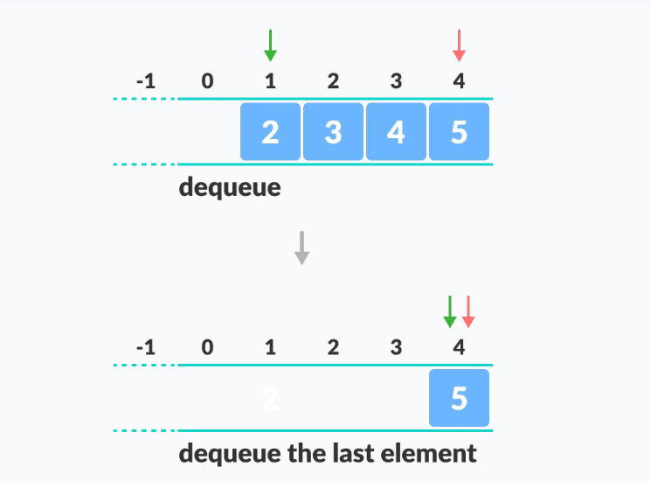
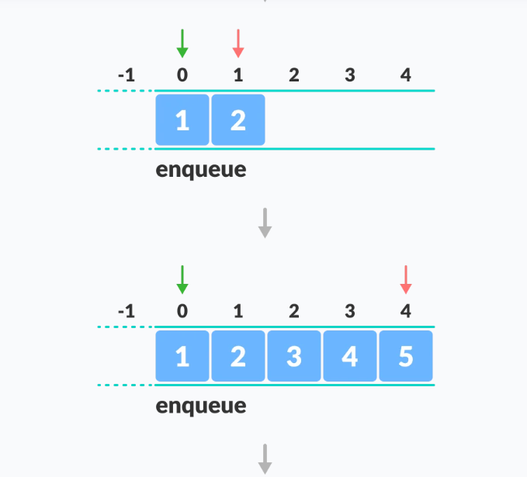
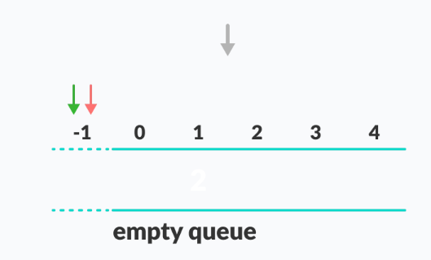
Queue

Slide 39
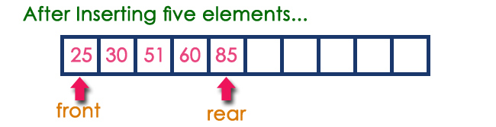
Queue
In a queue data structure,
the insertion operation is performed using a function called "enQueue()" and
deletion operation is performed using a function called "deQueue()".
Example
Queue after inserting 25, 30, 51, 60 and 85.
DeQueueing an empty queue is called underflow and
EnQueuing an element in a full queue is called overflow.
Generally, we treat them as exceptions

Slide 40
class Queue():
def __init__(self,n):
self.queue=[None]*n
self.front=-1
self.rear=-1
self.size=0
self.n=n
def is_empty(self):
return self.rear==-1
def is_full(self):
return (self.rear+1)==self.n
def queue_size(self):
return self.size
def queue_front(self):
return self.queue[self.front]
def enqueue(self,e):
if self.is_empty():
self.front=0
self.rear=0
elif self.is_full():
raise Exception("queue is full")
else:
self.rear+=1
self.size+=1
self.queue[self.rear]=e
def dequeue(self):
if self.is_empty():
raise Exception("queue is empty")
elif self.front==self.rear:
temp=self.queue[self.front]
self.queue[self.front]=None
self.front=-1
self.rear=-1
self.size=0
else:
temp=self.queue[self.front]
self.queue[self.front]=None
self.front+=1
self.size-=1
return temp

Slide 41
Advantages of Queue:
A large amount of data can be managed efficiently with ease.
Operations such as insertion and deletion can be performed with ease as it follows the First In First Out rule.
Queues are useful when a particular service is used by multiple consumers.
Queues can be used in the implementation of other data structures.

Slide 42
Disadvantages of Queue:
The operations such as insertion and deletion of elements from the middle are time consuming.
Limited Space.
In a classical queue, a new element can only be inserted when the existing elements are deleted from the queue.
Maximum size of a queue must be defined prior.

Slide 43
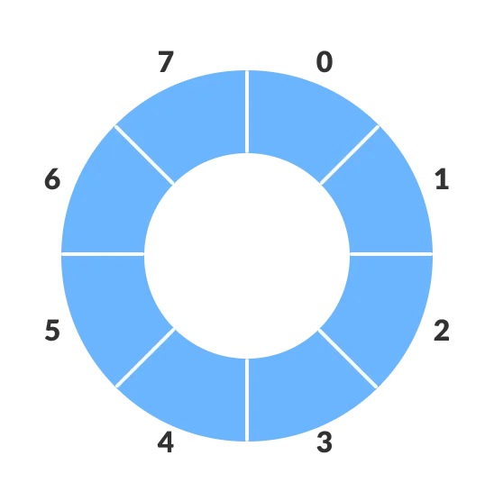
Circular Queue
A circular queue is the extended version of a regular queue where the last element is connected to the first element. Thus forming a circle-like structure.

Slide 44
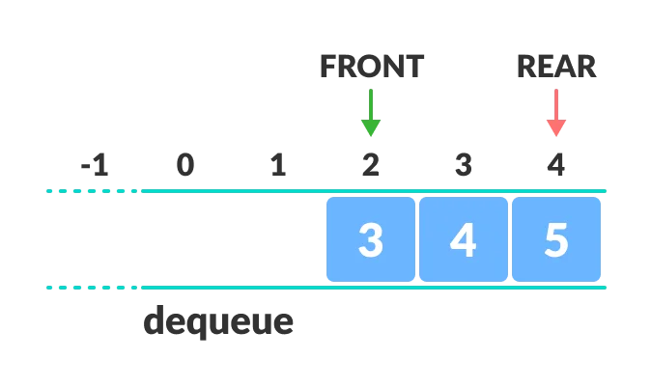
The circular queue solves the major limitation of the normal queue. In a normal queue, after a bit of insertion and deletion, there will be non-usable empty space.
Here, indexes 0 and 1 can only be used after resetting the queue
(deletion of all elements). This reduces the actual size of the queue.

Slide 45
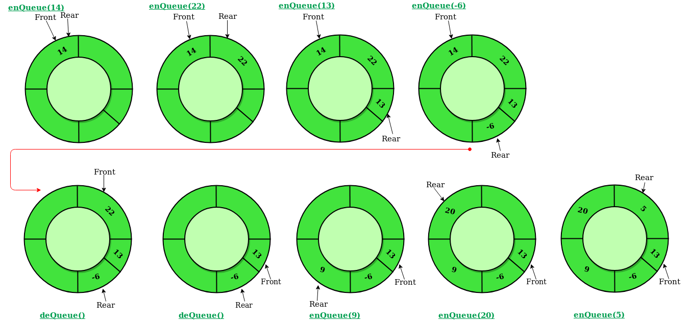

Slide 46
Circular Queue Operations
The circular queue work as follows:
two pointers FRONT and REAR
FRONT track the first element of the queue
REAR track the last elements of the queue
initially, set value of FRONT and REAR to -1`

Slide 47
Enqueue Operation
check if the queue is full
for the first element, set value of FRONT and REAR to 0
circularly increase the REAR index by 1 (i.e. if the rear reaches the end, next it would be at the start of the queue)
add the new element in the position pointed to by REAR

Slide 48
Dequeue Operation
check if the queue is empty
return the value pointed by FRONT
circularly increase the FRONT index by 1
for the last element, reset the values of FRONT and REAR to -1

Slide 49
Applications of Circular Queue
Memory Management: The unused memory locations in the case of ordinary queues can be utilized in circular queues.
Traffic system: In computer controlled traffic system, circular queues are used to switch on the traffic lights one by one repeatedly as per the time set.
CPU Scheduling: Operating systems often maintain a queue of processes that are ready to execute or that are waiting for a particular event to occur.

